Slide 1

Evolutionary Robotics
Rohan Arya 20086377
Oussoubi Niakate 20242905
Jai . 20045247
Dennis Kolomyiets 20250762

Slide 2

Introduction to the field
Robotics
Artificial Intelligence
Evolutionary Robotics
Autonomous military drones, self-cleaning vacuum cleaners

Slide 3
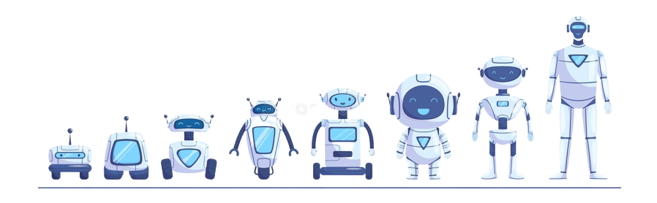
What is evolutionary robotics?
Employs evolutionary computation.
Adapt to environment through analogous to natural evolution.
Survival of the fittest, embodied in the neo-Darwinian synthesis
Organized along 2 axes of research
Cognitive Science and Biology
Engineering
Applied to create control system for robots, generate robot body plans, and coevolve control systems and body plans simultaneously

Slide 4
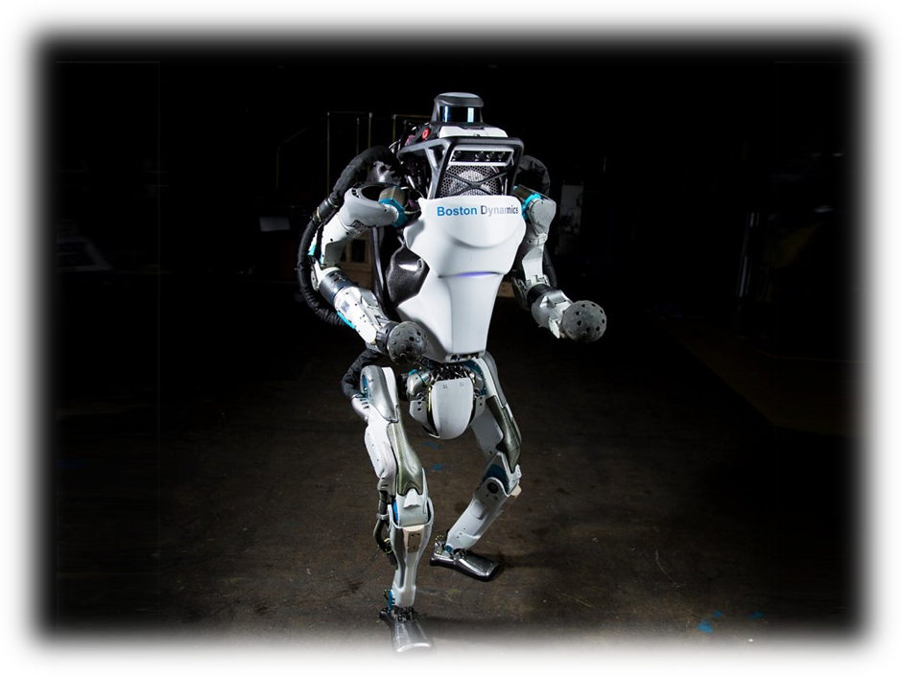
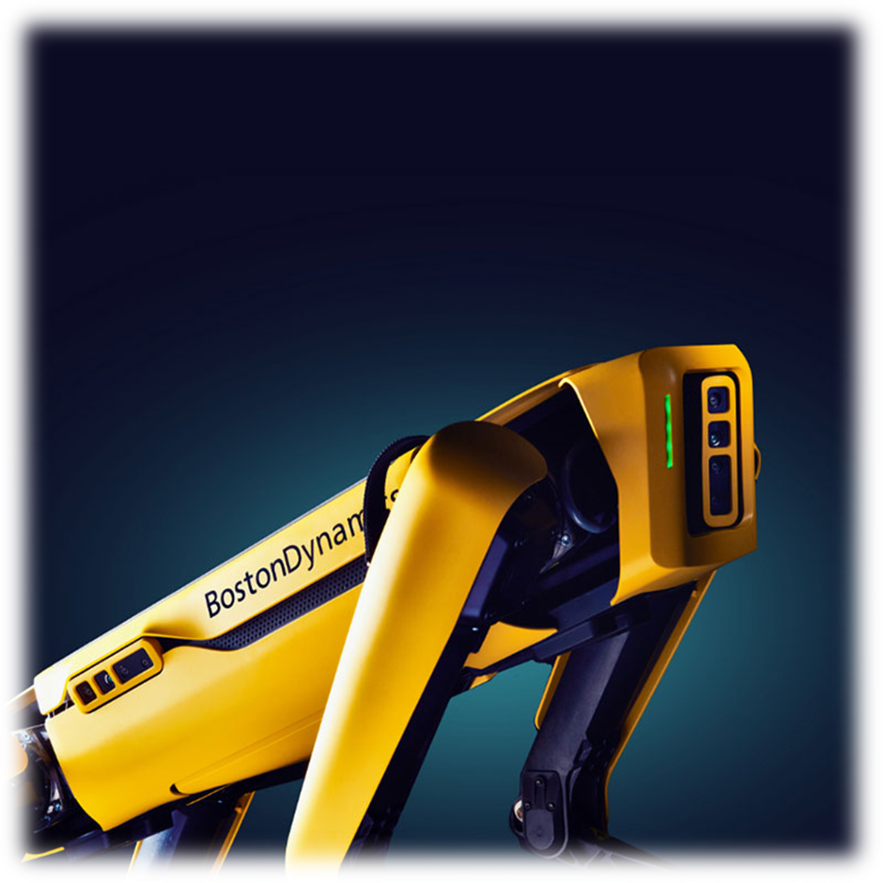
Boston Dynamics
Specialize in developing advanced, mobile robots that move and perform tasks in challenging environments.
Robots are designed to mimic the movements and behaviors of animals and humans.
Equipped with advanced sensors and control systems that allow them to move with agility and speed, and to adapt to changing environments.
Atlas has become a sensation on the internet for its ability to perform acrobatic feats like backflips and jumps, along with spot and LS3 in military as well.

Slide 5
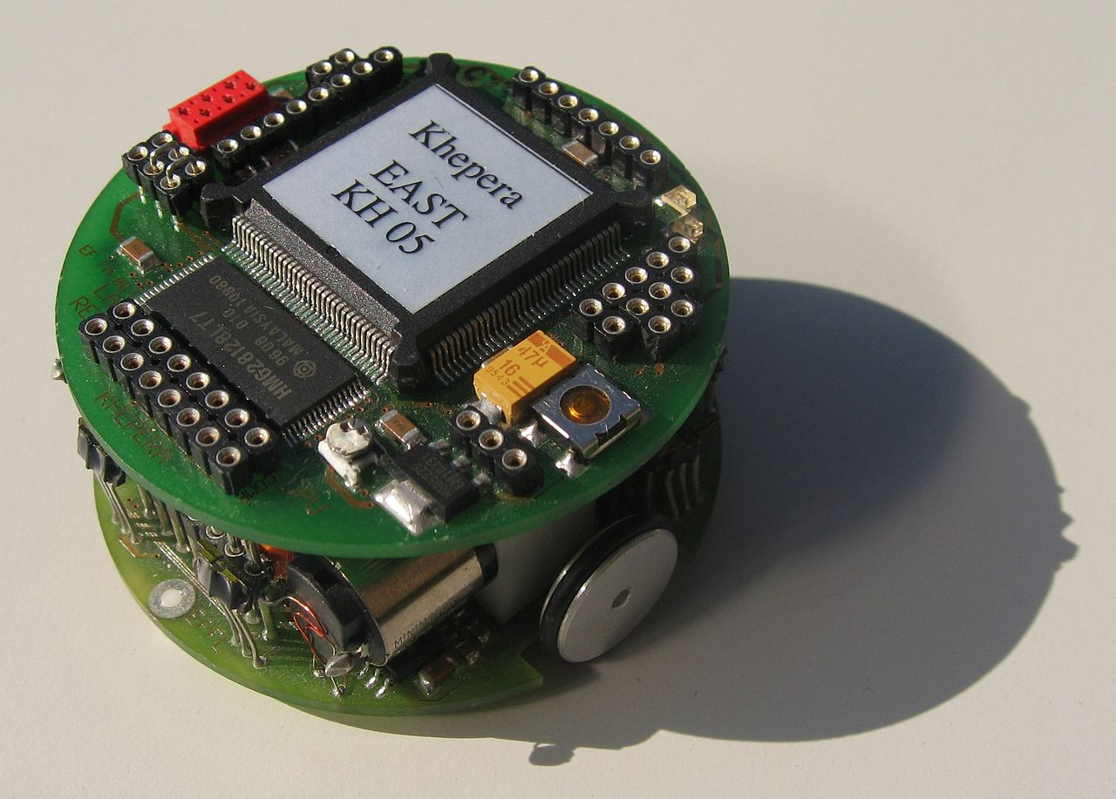
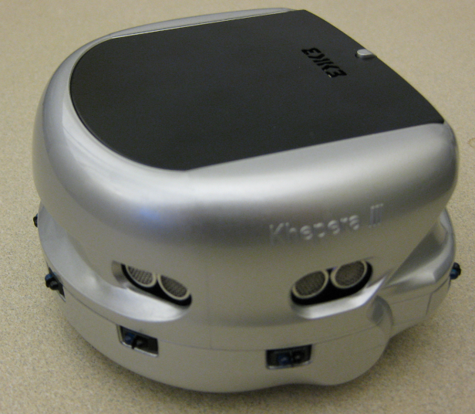
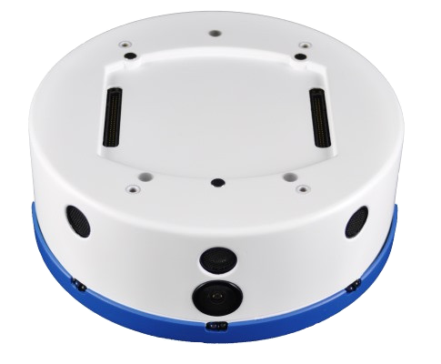
Applications and Impact of evolutionary robotics
Ver. 1
Kephera Robot
Created by K-TEAM
Had an impact in earlier development of AI starting in the 90’s
Latest version released in 2014
Ver. 3
Ver. 4

Slide 6
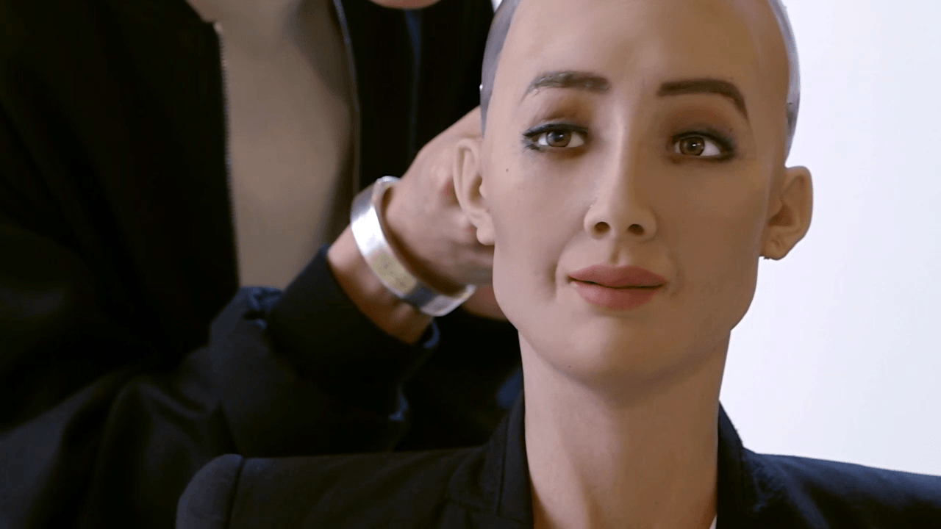

Sophia
Created by Hanson Robotics
Popularised when featured on talk shows
Holds Citizenship in Saudi Arabia
Has created and sold a self portrait for nearly $700,000

Slide 7

Open Issues of evolutionary robotics
The bootstrap problem/deception
Genomic encoding/genotype-phenotype mappings
Enables evolution of complex structures
Usually biased
The reality gap
Controllers evolved in simulation prove in effective in physical robots
Time required to evolve controllers directly on real robots

Slide 8
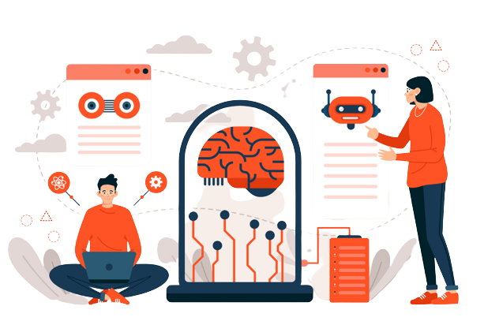
Further Issues
Combining Evolution and Learning
Reinforcement learning
Online learning

Slide 9
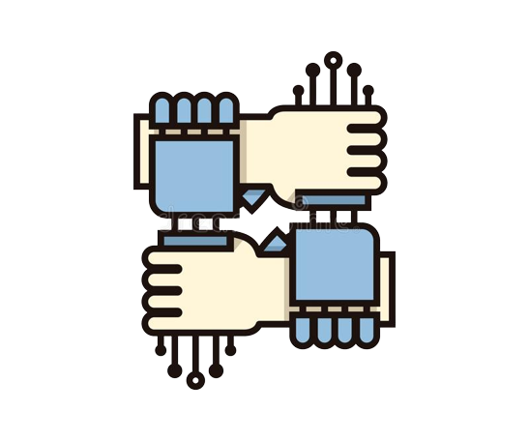
Solutions and countermeasures
Bootstrap problem:
Often recognised as one of the main challenges of evolutionary robotics
Directly assist evolutionary process
Incremental evolution
Behavioural decomposition
Reality gap:
Using less formalised approaches
Rely solely on real robots for controller evolution (extremely time consuming)

Slide 10

Conclusion
A research field that has matured over the years
Relies on multiple evaluations to produce any results
Contributed to engineering and biology
Engineering perspective:
Unique design process
Biological perspective:
Provides distinctive and powerful tools for experimental work on evolution

Slide 11
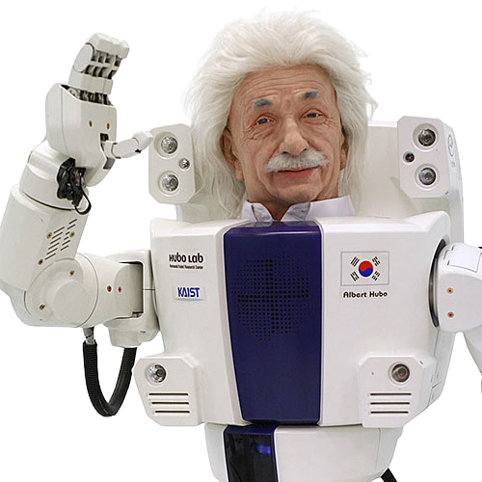
Thank you

